Slide 1
Lecture 9 Statistics in R
Trevor A. Branch
FISH 552 Introduction to R

Slide 2
Outline
Probability distributions
Exploratory data analysis
Comparison of two samples

Slide 3
Random variables (formal)
“a random variable X is normally distributed”
For a sample space S a random variable is any rule that associates a number with each outcome in S
A random variable X is continuous if its set of possible values is an entire interval of numbers
A random variable X is discrete if its set of possible values is a finite set or an infinite sequence
Often we describe observations using discrete probability models (e.g. binomial, Poisson), or continuous probability models (e.g. normal, lognormal)

Slide 4
Probability distributions in R
R includes a comprehensive set of probability distributions that can be used to simulate and model data
If the function for the probability model is named xxx
pxxx: evaluate the cumulative distribution P(X ≤ x)
dxxx: evaluate the probability mass/density function f(x)
qxxx: evaluate the quantile q, the smallest x such that P(X ≤ x) > q
rxxx: generate a random variable from the model xxx

Slide 5
Probability distributions in R
Distribution | R name | Additional arguments
beta | beta | shape1, shape2
binomial | binom | size, prob
Cauchy | cauchy | location, scale
chi-squared | chisq | df
exponential | exp | rate
F | f | df1, df2
gamma | gamma | shape, scale
geometric | geom | prob
hypergeometric | hyper | m,n, k
lognormal | lnorm | meanlog, sdlog
logistic | logis | location, scale
negative binomial | nbinom | size, prob
normal | norm | mean,sd
Poisson | pois | lambda
Student’s t | t | df
uniform | unif | min, max
Weibull | weibull | shape, scale
Wilcoxon | wilcox | m,n

Slide 6
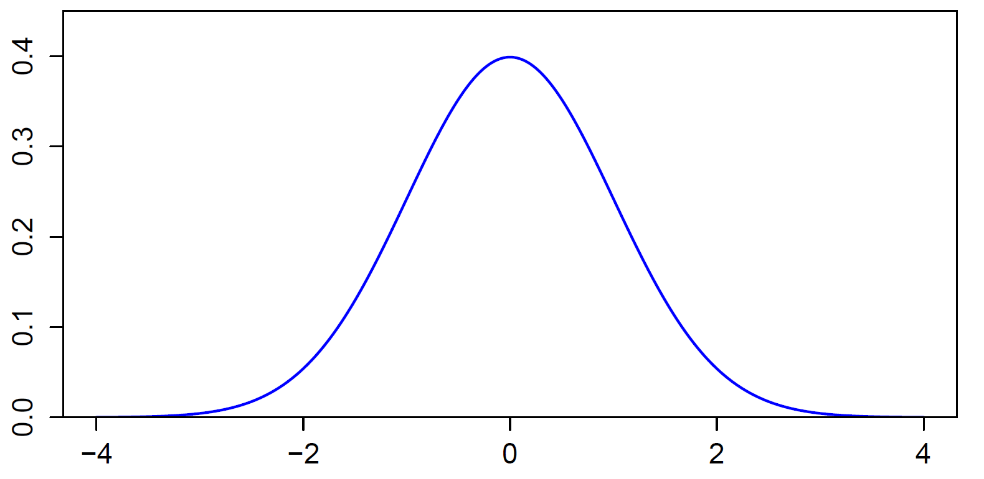
Standard normal distribution

Slide 7
Functions for normal distribution
Values of x for different quantiles
qnorm(p, mean=0, sd=1, lower.tail=TRUE, log.p=FALSE)
> quants <- qnorm(c(0.01,0.025,0.05,0.95,0.975,0.99))
> round(quants,2)
[1] -2.33 -1.96 -1.64 1.64 1.96 2.33
Probability of observing value x or smaller
pnorm(q, mean=0, sd=1, lower.tail=TRUE, log.p=FALSE)
> pnorm(quants)
[1] 0.010 0.025 0.050 0.950 0.975 0.990

Slide 8
Standard normal
Density
dnorm(x, mean = 0, sd = 1, log.p = FALSE)
> dnorm(quants)
[1] 0.02665214 0.05844507 0.10313564 0.10313564
[5] 0.05844507 0.02665214
Generating random normal variables
rnorm(n, mean = 0, sd = 1)
> rnorm(n=10)
[1] 1.91604284 0.41294905 -0.23959763 0.21590614
[5] 1.32797569 -0.19704848 -0.04746724 0.92903915
[9] 0.37813679 0.45441023
The height (“density”) of the normal curve
Rerun and you get different values

Slide 9
Random number generation
Computers generate pseudorandom numbers using a sequence of specially chosen numbers and algorithms
Each sequence of numbers starts at a random seed with values in .Random.seed
By default the random sequence is initialized based on the start time of the program
For repeatable pseudorandom sequences first call set.seed(seed) with seed = any integer between −2147483648 (-2³¹) and 2147483647 (2³¹-1)

Slide 10
Simulating data
When simulating data or working with random numbers, it is often a good idea to use set.seed() and save the script detailing which number was used
This ensures you can exactly repeat your results
> set.seed(100)
> rnorm(3)
[1] -0.50219235 0.13153117 -0.07891709
> rnorm(3)
[1] 0.8867848 0.1169713 0.3186301
> set.seed(100)
> rnorm(3)
[1] -0.50219235 0.13153117 -0.07891709
> rnorm(3)
[1] 0.8867848 0.1169713 0.3186301

Slide 11
The sample() function
To generate random numbers from discrete sets of values
With or without replacement
Equal probability or weighted probability
This is the function that underlies many modern statistical techniques
Resampling
Bootstrapping
Markov-chain Monte-Carlo (MCMC)

Slide 12
Using sample()
Roll 10 dice
> sample(1:6,size=10,replace=T)
[1] 2 3 5 5 2 3 3 5 4 5
Flip a coin 10 times
> sample(c("H","T"), size=10, replace=T)
[1] "H" "T" "T" "T" "H" "T" "T" "H" "H" "T"
Pick 5 cards from a deck of cards
> cards <- paste(rep(c("A",2:10,"J","Q","K"),4),
c("Club","Diamond","Heart","Spade"))
> sort(cards) #check that this worked!
> sample(cards,5)
[1] "7 Club" "6 Diamond" "J Heart" "7 Spade"
[5] "K Heart"

Slide 13
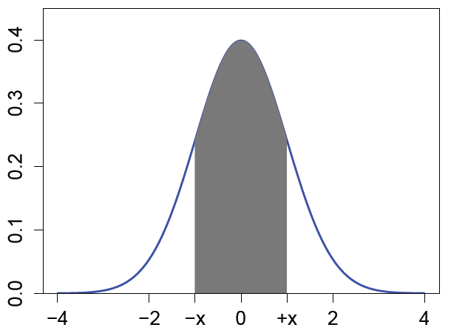
Hands-on exercise 1
Generate 100 random normal numbers with mean 80 and standard deviation 10. What proportion of these are ≥2 standard deviations from the mean?
Select 6 numbers from a lottery containing 56 balls. Go to http://www.walottery.com/sections/WinningNumbers/
Did you win?
For a standard normal random
variable, find the number x
such that P(-x ≤ X ≤ x) = 0.24
(use symmetry, see diagram)
find x
so that shaded area is 0.24

Slide 14
Exploratory data analysis
Important starting point in any analysis
Numerical summaries that quickly tell you things about your data
summary()
boxplot()
fivenum()
sd()
range()
Visualizing your data is usually much more informative, find which built-in plot is more useful

Slide 15
Recall the iris data
> iris
Sepal.Length Sepal.Width Petal.Length Petal.Width Species
1 5.1 3.5 1.4 0.2 setosa
2 4.9 3.0 1.4 0.2 setosa
3 4.7 3.2 1.3 0.2 setosa
...
51 7.0 3.2 4.7 1.4 versicolor
52 6.4 3.2 4.5 1.5 versicolor
...
101 6.3 3.3 6.0 2.5 virginica
102 5.8 2.7 5.1 1.9 virginica

Slide 16
pairs()
Quickly produces a matrix of scatterplots
> pairs(iris[,1:4])
> pairs(iris[,1:4],
main = "Edgar Anderson's Iris Data",
pch = 21,
bg = rep(c("red", "green3", "blue"),
table(iris$Species)) )
final two lines: repeats "red" 50 times, "green3" 50 times and "blue" 50 times, to assign these colors to the circles for each species

Slide 17
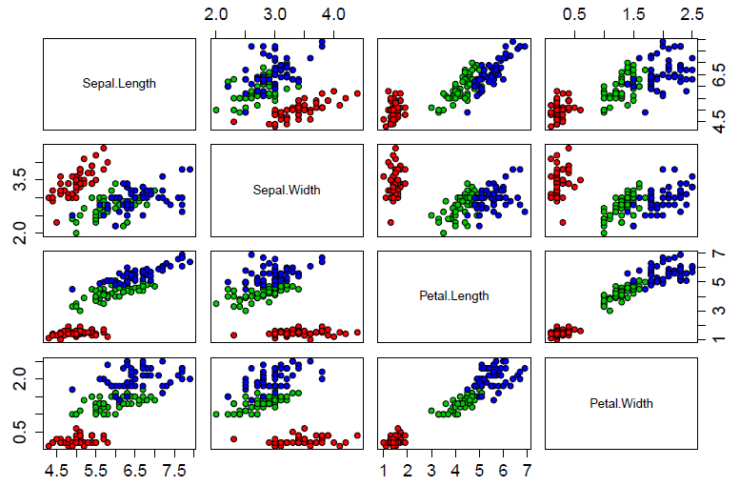

Slide 18
Histograms
Quick and easy way of seeing data shape, center, skewness, and any outliers
?hist (many options)
When values are continuous, measurements are subdivided into intervals using breakpoints ("breaks")
Many ways of specifying breakpoints
Vector of breaks
Number of breaks
Name of a general built-in algorithm

Slide 19
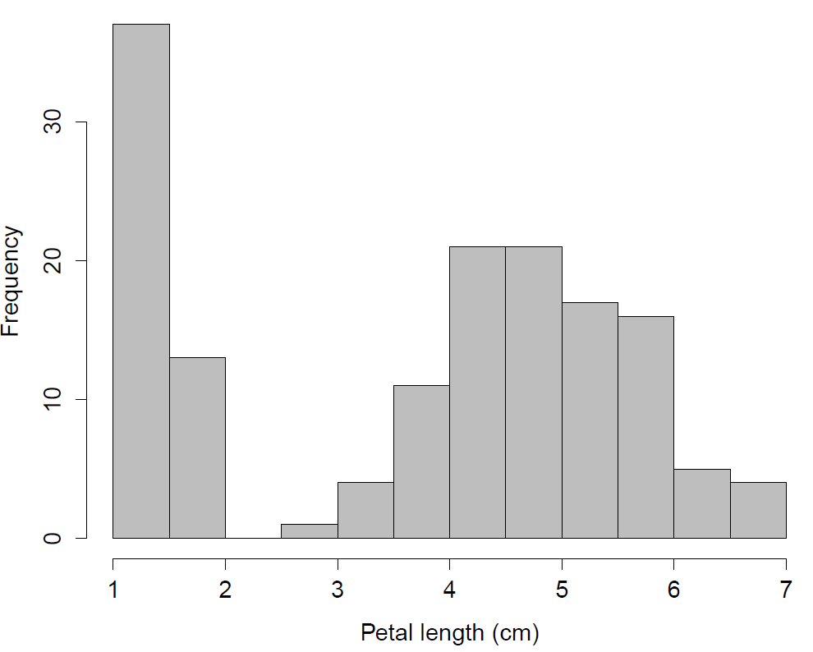
hist(iris$Petal.Length, main="", col="gray", xlab="Petal length (cm)")

Slide 20
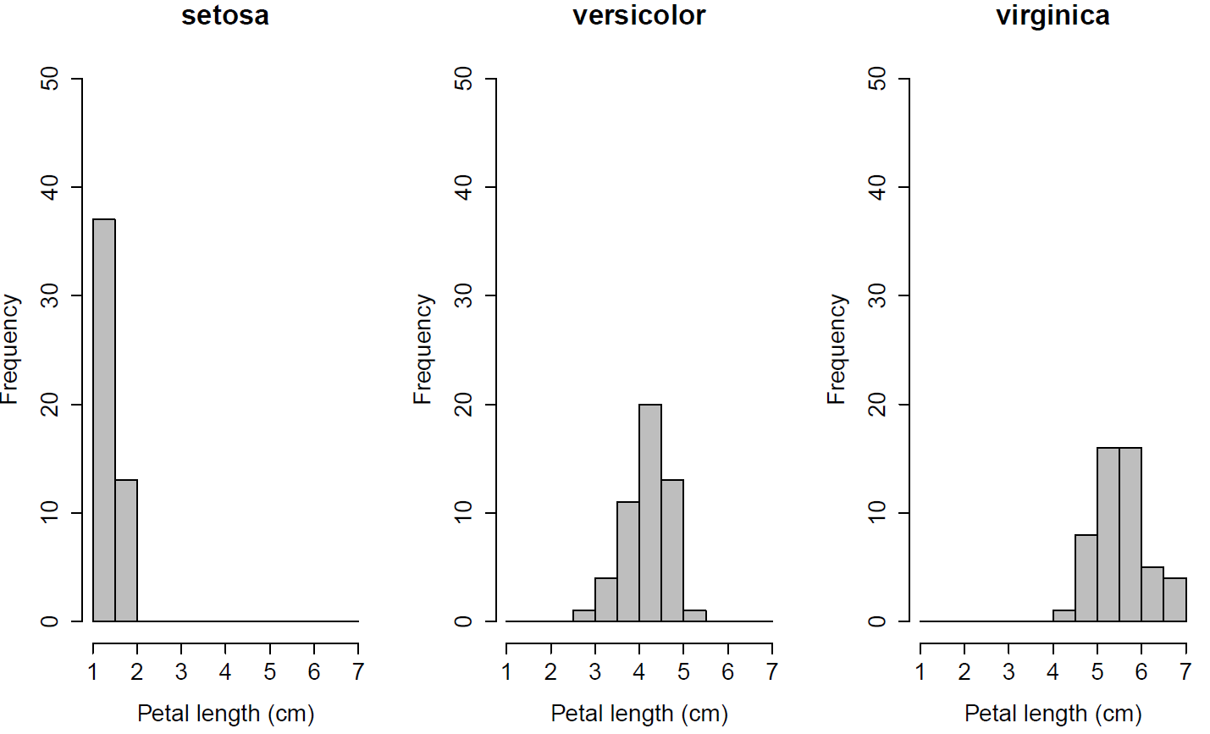
Separate plots by species

Slide 21
Adding density curves
Kernel density estimation using the density() function is a non-parametric way of estimating the underlying probability function
The higher the bandwidth the smoother the resulting curve
Usually best to let R choose the optimal value for the bandwidth to avoid bias
Many different kernel density methods, best to use the default for most purposes

Slide 22
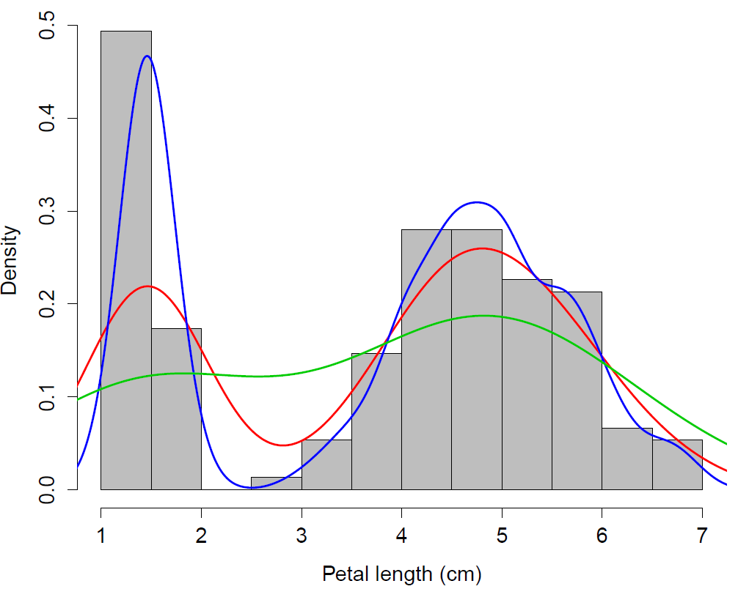
hist(iris$Petal.Length, main="", col="gray", xlab="Petal length (cm)", freq=F) lines(density(iris$Petal.Length), lwd=2, col="red") lines(density(iris$Petal.Length,adjust=0.4), lwd=2, col="blue") lines(density(iris$Petal.Length,adjust=2), lwd=2, col="green3")
Smaller
bandwidth
Default
bandwidth
Higher
bandwidth

Slide 23
Other useful plots
Plot | R function
Barplot | barplot()
Contour lines of two-dimensional distribution | contour()
Plot of two variables conditioned on the other | coplot()
Represent 3-D using shaded squares | image()
Dotchart | dotchart()
Pie chart | pie()
3-dimensional surface plot | persp()
Quantile-quantile plot | qqplot()
Stripchart | stripchart()

Slide 24
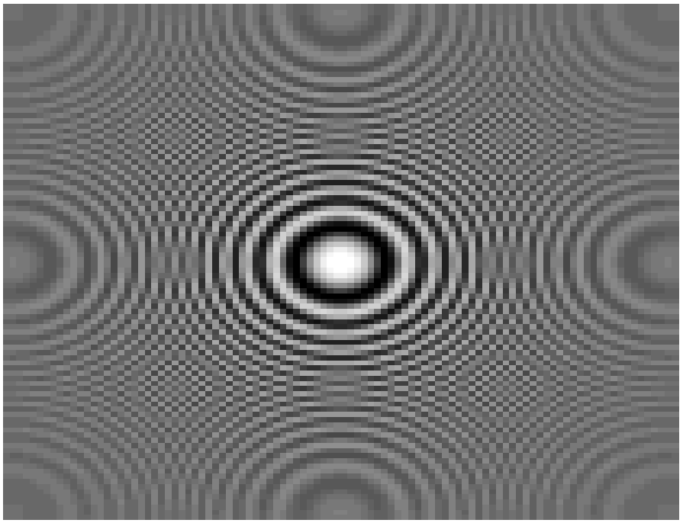
Created using image(): squares each with a different gray shading

Slide 25
Basic statistical tests in R
R has a bewildering array of built-in functions to perform classical statistical tests
Correlation cor.test()
Chi-squared chisq.test()
In the next lecture
ANOVA anova()
Linear models lm()
And many many more...

Slide 26
Comparison of two samples
The t-test examines whether two population means, with unknown population variances, are significantly different from each other
H₀: µ₁ – µ₂ = 0
H₁: µ₁ – µ₂ ≠ 0
The two-sample independent t-test assumes
Populations are normally distributed (not an issue for large sample sizes)
Equal variances (assumption can be relaxed)
Independent samples

Slide 27
Using t.test()
The t.test() function in R can be used to perform many variants of the t-test
?t.test
Specify one- or two-tailed
Specify µ
Specify significance level α
Example: two methods were used to determine the latent heat of ice. The investigator wants to find out how much (and if) the methods differed
methodA <- c(79.982, 80.041, 80.018, 80.041, 80.03, 80.029, 80.038, 79.968, 80.049, 80.029, 80.019, 80.002, 80.022)
methodB <- c(80.02, 79.939, 79.98, 79.971, 79.97, 80.029, 79.952, 79.968)

Slide 28
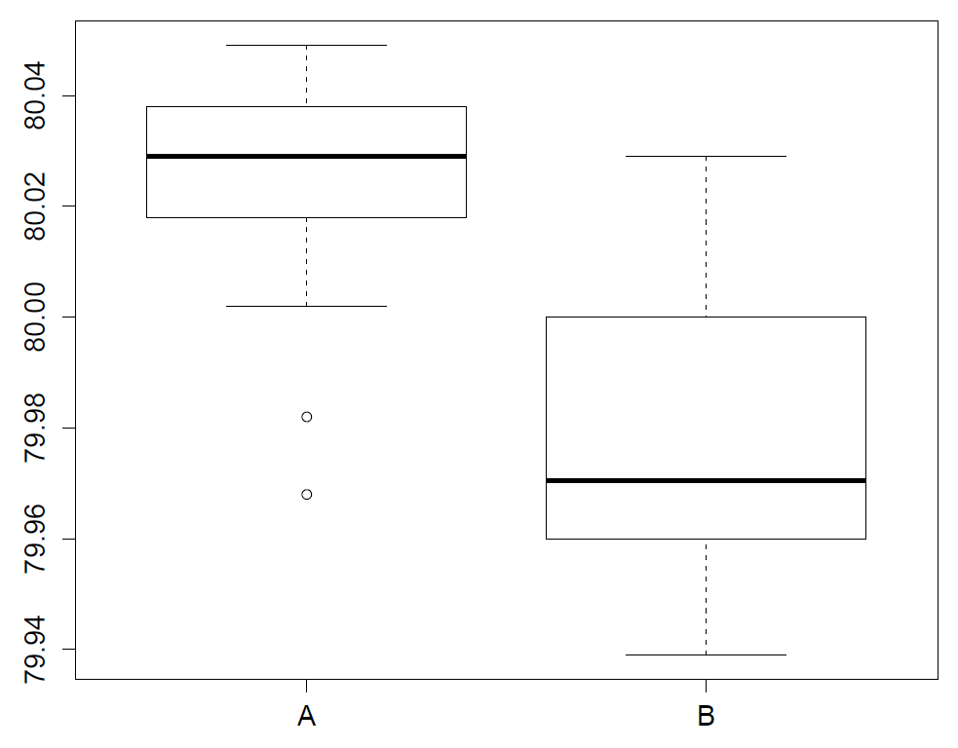
Rule 1: plot the data

Slide 29
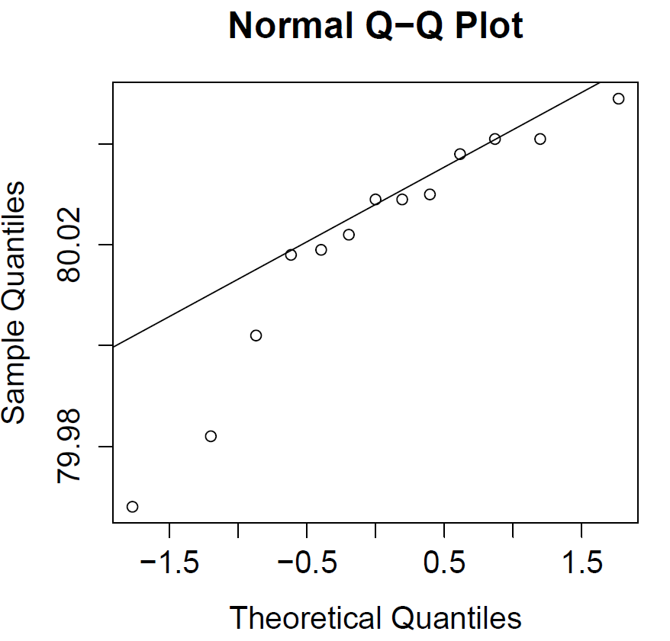
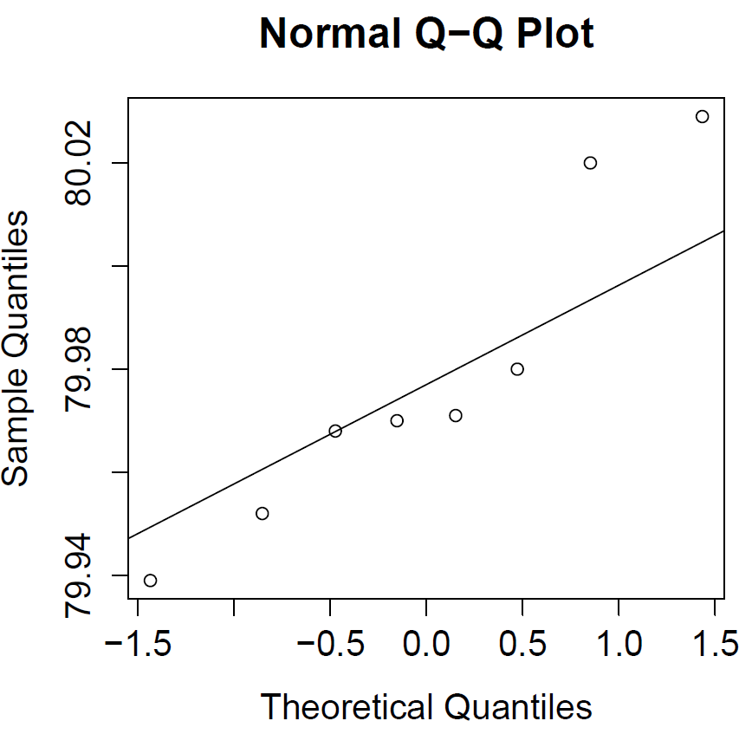
Data normally distributed?
If normal, points should fall on the line of a qqnorm() plot. Here A has a strong left skew, B a right skew
qqnorm(methodA); qqline(methodA)
Method A
Method B

Slide 30
t-test
The default in R is the Welch two-sample t-test which assumes unequal variances
> t.test(methodA, methodB)
Welch Two Sample t-test
data: methodA and methodB
t = 3.274, df = 12.03, p-value = 0.006633
alternative hypothesis: true difference in means is not equal to 0
95 percent confidence interval:
0.01405393 0.06992684
sample estimates:
mean of x mean of y
80.02062 79.97862

Slide 31
Accessing output
The results of a statistical test can be saved by assigning a name to the output and accessing individual elements
The results are stored in a list (actually an object)
> resultsAB <- t.test(methodA, methodB)
> names(resultsAB)
[1] "statistic" "parameter" "p.value"
[4] "conf.int" "estimate" "null.value"
[7] "alternative" "method" "data.name"
> resultsAB$p.value
[1] 0.006633411

Slide 32
Equal variances?
The boxplot suggests that the variances of the two methods might be similar
> var(methodA)
[1] 0.0005654231
> var(methodB)
[1] 0.0009679821
More formally we can perform an F-test to check for equality in variances

Slide 33
F-test
If we take two samples n₁ and n₂ from normally distributed populations, then the ratio of the variances is from an F-distribution with degrees of freedom (n₁–1; n₂–1)
H₀: σ²₁ / σ²₂ = 1
H₁: σ²₁ / σ²₂ ≠ 1

Slide 34
Use var.test() in R
> var.test(methodA, methodB)
F test to compare two variances
data: methodA and methodB
F = 0.5841, num df = 12, denom df = 7, p-value = 0.3943
alternative hypothesis: true ratio of variances is not equal to 1
95 percent confidence interval:
0.1251922 2.1066573
sample estimates:
ratio of variances
0.5841255
There is no evidence of a significant difference between the two variances

Slide 35
Redo t-test with equal variances
> t.test(methodA, methodB, var.equal = TRUE)
Two Sample t-test
data: methodA and methodB
t = 3.4977, df = 19, p-value = 0.002408
alternative hypothesis: true difference in means is not equal to 0
95 percent confidence interval:
0.01686368 0.06711709
sample estimates:
mean of x mean of y
80.02062 79.97862
(Previously p = 0.006633)

Slide 36
Non-parametric tests
We showed earlier using qqplot() that the normality assumption is violated, particularly an issue since the sample sizes here were small
The two-sample Wilcoxon (Mann-Whitney) test is a useful alternative when the assumptions of the t-test are not met
Non-parametric tests rely on the rank order of the data instead of the numbers in the data itself

Slide 37
Mann-Whitney test
How the test works
Arrange all the observations into a ranked (ordered) series
Sum the ranks from sample 1 (R₁) and sample 2 (R₂)
Calculate the test statistic U
The distribution under H₀ is found by enumerating all possible subsets of ranks (assuming each is equally likely), and comparing the test statistic to the probability of observing that rank
This can be cumbersome for large sample sizes

Slide 38
Caveats
When there are ties in the data, this method provides an approximate p-value
If the sample size is less than 50 and there are no ties in observations, by default R will enumerate all possible combinations and produce an exact p-value
When the sample size is greater than 50, a normal approximation is used
The function to use is wilcox.test()
?wilcox.test

Slide 39
Results of Mann-Whitney test
> wilcox.test(methodA, methodB)
Wilcoxon rank sum test with continuity correction
data: methodA and methodB
W = 88.5, p-value = 0.008995
alternative hypothesis: true location shift is not equal to 0
Warning message:
In wilcox.test.default(methodA, methodB) :
cannot compute exact p-value with ties
Once again we reach the same conclusion

Slide 40
Hands-on exercise 2
Create 10 qqnorm plots (including qqline) by sampling 30 points from the following four distributions
normal, exponential, t, cauchy
Make between 2 and 5 of the plots come from a normal distribution
Have your partner guess which plots are actually from a normal distribution

